Slide 1
Linear data structures

Slide 2
Agenda
Linear data structure
Types of linear data structures
Applications of linear data structures.

Slide 3
Linear data structure
Data Structure in which data elements are arranged in sequential manner where every data element is connected to its previous and next element which allows us to traverse between the list of elements in one go is called Linear data structure.

Slide 4
Types of linear data structures
Linear data structure can be implemented using various concepts. They are:
1 | Arrays: | used to store data of same type
2 | Stacks: | follows Last In First Out (LIFO) approach and can handle different types of data.
3 | Queues: | follows First In First Out (FIFO) approach or Last In Last Out (LILO) approach.
4 | LinkedList: | can modify data elements in any order.

Slide 5


34 | 27 | 12 | 78 | 62 | 18
Head
node
node
node

Slide 6
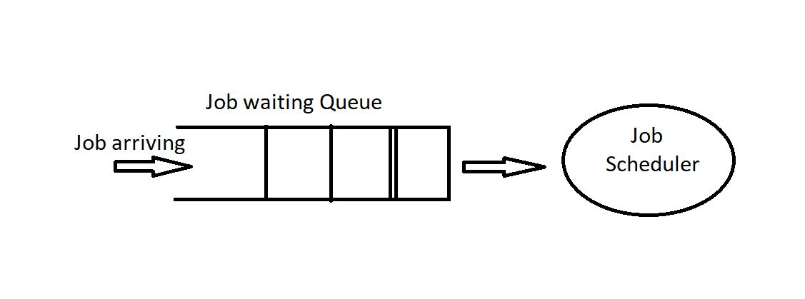

Applications of linear data structures
Back and forward options in File Explorer in windows, chrome.
Job scheduling, CPU scheduling, Disk Scheduling
And many more applications.
Undo Redo

Slide 7
Summary
We have understood linear data structures and its types.
Applications of Linear data Structures are also seen.

Slide 8
Thank You
Proprietary content. ©Great Learning. All Rights Reserved. Unauthorized use or distribution prohibited

